Slide 1
Knowledge Thread 1 - Session 0
2DX4 Computer Engineering
Joshua Fitzpatrick
Ama Simons

Slide 2
This Studio covers…
Conditioning Analog Signals for Digitization
Amplification of Signals
Keil Debugger to visualize the flow of code

Slide 3
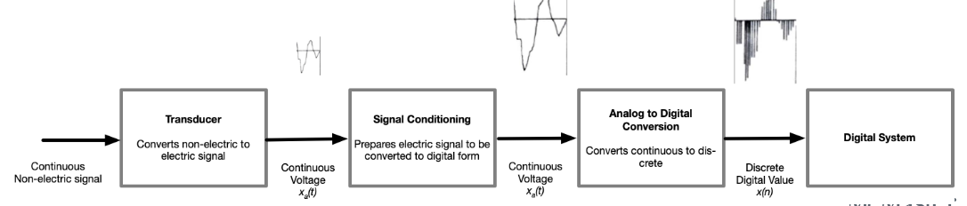
Why are we doing this?
Remember from Lecture:
The signal must be conditioned to make it suitable for the ADC process. For example, amplification and filtering

Slide 4
You will need …
Analog Discovery (AD2) and Diligent Waveforms 2015 software
AD2 and Waveforms 2015 Reference Manuals
Data sheet for LMC662 Dual Operational Amplifier (Op-amp)
2DX4 parts kit (LMC662 Op-amp, breadboard, AD2, resistors)
Your Microcontroller (Code Visualization)

Slide 5
Let’s begin (DEMO) You have 20-ish mins to complete the first exercise. Come back to general after the discussion

Slide 6
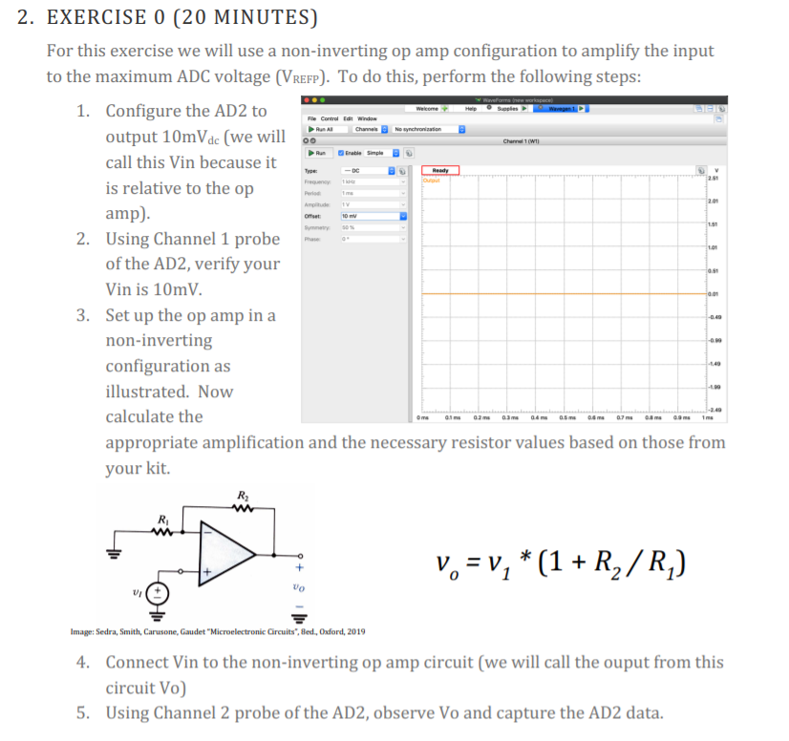

Slide 7
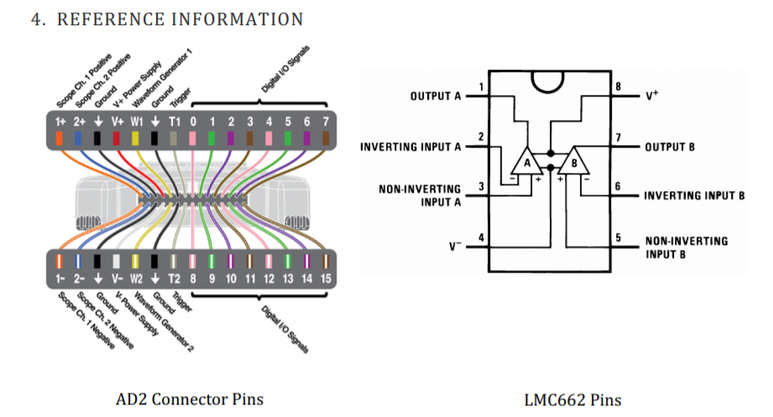
Reference Info

Slide 8
Discuss (in your Tables)
1. What would Vo be if Vin (dc) was a negative voltage?
2. When considering the textbook ideal vs. the actual op amp circuit, what considerations are there regarding the op amp power supply?
3. The ADC has a defined range of voltage input – what happens to the digitized value when the input voltage exceeds this range?

Slide 9
Keil Debugger to visualize the flow of code
Let us open back up Studio1Answers and visualize the flow of code through the debugger
We will step through each line of code
This can help to show you if the code is working or not working

